Slide 1




Slide 2

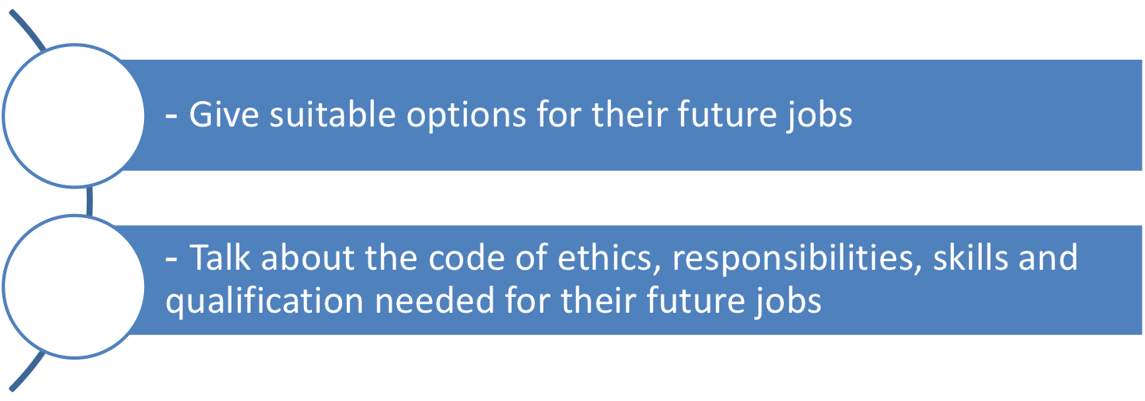


At the end of this unit, students will be able to:

Slide 3

Objective: Upon completion of this activity, students will be able to identify the suitable jobs for certain education, qualifications and experiences.
- Work in groups - Find a suitable job for the people with their education, qualifications and work experience - Cross check

Slide 4
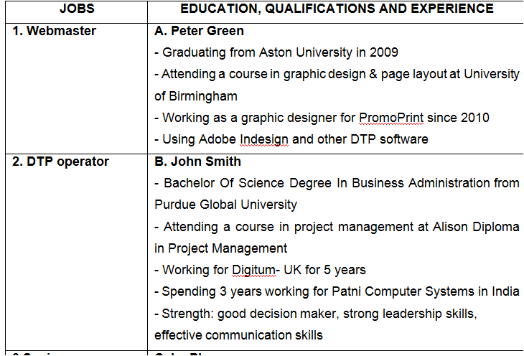

Slide 5
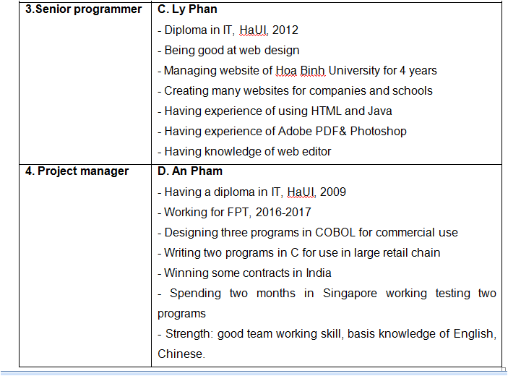


Slide 6

1. Webmaster
2. DTP operator
C. Ly Phan - Having diploma in IT, HaUI, 2017 - Being good at web design - Managing website of Hoa Binh University for 4 years - Creating many websites for companies and schools - Having experience of using HTML and Java - Having experience of Adobe PDF& Photoshop - Having knowledge of web editor
A. Peter Green - Graduating from Aston University in 2009 - Attending a course in graphic design & page layout at University of Birmingham - Working as a graphic designer for PromoPrint since 2010 - Using Adobe Indesign and other DTP software

Slide 7
3. Senior programmer
D. An Pham: - Having diploma in IT, HaUI, 2009 - Working for FPT, 2016-2017 - Designing three programs in COBOL for commercial use Writing two programs in C for use in large retail chain - Winning some contracts in India - Spending two months in Singapore working testing two programs - Strength: good team working skill, basis knowledge of English, Chinese.

Slide 8
3. Senior programmer | D. An Pham: - Having diploma in IT, HaUI, 2009 - Working for FPT, 2016-2017 - Designing three programs in COBOL for commercial use Writing two programs in C for use in large retail chain - Winning some contracts in India - Spending two months in Singapore working testing two programs - Strength: good team working skill, basis knowledge of English, Chinese.

Slide 9

4. Project manager
B. John Smith - Being Bachelor of Science Degree in Business Administration from Purdue Global University - Attending a course in project management at Alison Diploma in Project Management - Working for Digitum- UK for 5 years - Spending 3 years working for Patni Computer Systems in India - Strength: good decision maker, strong leadership skills, effective communication skills

Slide 10

Objective: Upon completion of this activity, students will be able to give advice on choosing future jobs
- Work in groups
- Give advice on choosing a suitable job for four people above using the grammar structures online
- Present to the class
- Listen and give comments

Slide 11
Example
1. I think, Ly Phan should apply for the position of a webmaster. It can be suitable for her because she received the Diploma in IT in 2012. She has managed the Website of Hoa Binh University for 4 years. She’s good at designing websites. She has created many websites for companies and schools. She has ever used HTML and Java. She has experience of Adobe PDF& Photoshop and knowledge of web editor.

Slide 12
Example
2. In my opinion, Peter Green can apply for the position of a DTP operator. He graduated from Aston University in 2009. Then he went on to do a course in graphic design & page layout at University of Birmingham. He has been/ worked as a graphic designer for PromoPrint since 2010. He also can use Adobe Indesign and other DTP software.

Slide 13
Example
3. We advise An Pham to choose the position of a Senior programmer because she received her Diploma in IT from HaUI in 2009 and she worked for FPT from 2016 to 2017. She has designed three programs in COBOL for commercial use and she has also written two programs in C for use in large retail chain. She has won some contracts in India. In 2018, she spent two months in Singapore working and testing two programs. She is good at team working skills. Besides, she has basis knowledge of English and Chinese.

Slide 14
Example
4. I think the position of a project manager would suit John Smith. He got the Bachelor of Science Degree in Business Administration from Purdue Global University. He went on to do a course in project management at Alison Diploma in Project Management. He has ever worked for Digitum- UK for 5 years. He has spent 3 years working for Patni Computer Systems in India. He is a good decision maker and he not only has strong leadership skills, but also effective communication skills.

Slide 15


Objective: Upon completion of this activity, students will be able to make a conversation to ask and answer questions about necessary things for future job options.
Work in pairs
Make a conversation to ask and answer questions about job options basing on the given information
Present to the class
Listen and give comments

Slide 16
Card A: Make a conversation with your partner to ask about Mark’s personal information (major, qualifications, year of graduation, work experience, strengths, job options)
Major | 1.____________________________ | Network security
Qualifications/ Degrees | 2.____________________________ | Diploma in Computer Science, London University
Year of graduation | 3.____________________________ | 2020
Work experience | 4.____________________________ | An intern at UK Technology Consultancy last summer holiday A technical support collaborator for Dell since March, 2019
Strengths | 5.____________________________ | A top troubleshooter in Vietnam Critical thinking
Weaknesses | Work overtime Sometimes hard to communicate | - Hot-tempered, sometimes late for work
Job options | 6. .____________________________ | Computer security specialist
What is his major?
What degrees/qualifications will he get from his university?
When/In what year is he going to graduate from university?
Has he had/got any work experience?
What is his work experience?
What are his strengths?
What job will suit him?/ What job will be suitable with/for him?

Slide 17
Card B: Make a conversation with your partner to ask about Brian’s personal information (major, qualifications, year of graduation, work experience, strengths, job options)
Major | Programming | 1._____________________
Qualifications/ Degrees | Bachelor’s degree in programming, Hanoi University of Science and Technology | 2._____________________
Year of graduation | 2021 | 3._____________________
Work experience | Work as a part-time software engineer for FPT Soft since October, 2019 Write over 10 programs in C and Visual Basic Take a three-month course game development in India at the end of this year | 4._____________________
Strengths | Skilled at using many programming languages such as COBOL, BASIC, C, JAVASCRIPT,… Good at languages: English, French Responsibility for the work Creative | 5._____________________
Weaknesses | Work overtime Sometimes hard to communicate | - Hot-tempeped, sometimes late for work
Job options | Programmer | 6._____________________

Slide 18
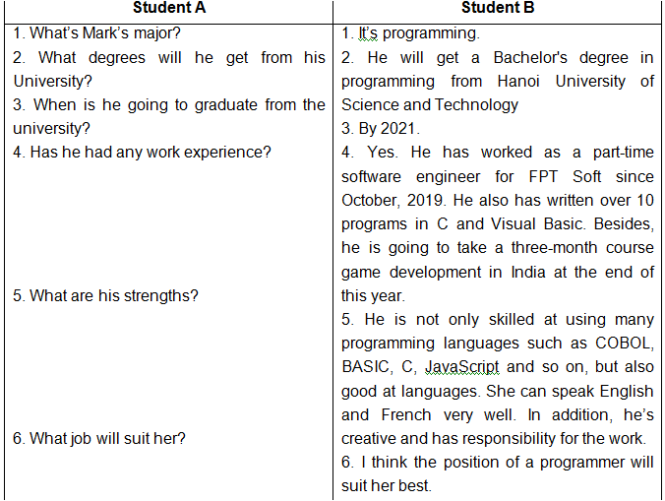

Slide 19
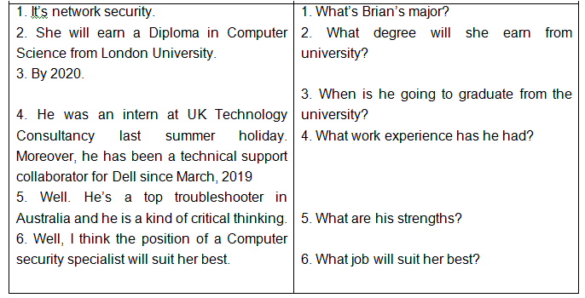

Slide 20

Objective: Upon completion of this activity, students will be able to identify necessary degrees, skills, responsibilities, codes of ethics for future jobs.
- Work in groups
- Read pieces of information related to responsibilities, qualifications/ degrees/ certificates, skills, codes of ethics which network and IT specialists may need to have, then discuss to put them into the correct columns.

Slide 21
Items | Related information
Responsiblities | Assist companies and organizations with managing hardware, software, networking and solving problems Install routers, switches, firewalls and network-related software programs Design, operate or maintain technology products Set up, support and maintain Local Area Networks (LANs), Wide Area Network (WANs), and other networking systems Determine the practicality of changes and modification of systems Monitor networks, document, network problems, and provide technical support for company personnel
Items | Network specialists | IT specialists
Responsiblities
- Install routers, switches, firewalls and network-related software programs
- Assist companies and organizations with managing hardware, software, networking and solving problems
- Set up, support and maintain Local Area Networks (LANs), Wide Area Network (WANs), and other networking systems
- Design, operate or maintain technology products
- Determine the practicality of changes and modification of systems
- Monitor networks, document, network problems, and provide technical support for company personnel

Slide 22
Items | Related information
Qualifications/Degrees/Certificates | Earn a bachelor’s degree in computer science, information technology, programming, computer engineering or a related field Get certificates on particular systems or technologies from vendors like Cisco, Oracle and Microsoft Obtain international certificates including Cisco Certified Network Associate (CCNA), Cisco Certified Network Professional (CCNP),… Have a broad knowledge of computer science subjects in courses in data structures, numerical analysis, data management and a variety of programming languages such as C++, C#, Javascript and Python
Items | Network specialists | IT specialists
Qualifications/Degrees/Certificates
- Earn a bachelor’s degree in computer science, information technology, programming, computer engineering or a related field
- Earn a bachelor’s degree in computer science, information technology, programming, computer engineering or a related field
- Get certificates on particular systems or technologies from vendors like Cisco, Oracle and Microsoft
- Obtain international certificates including Cisco Certified Network Associate (CCNA), Cisco Certified Network Professional (CCNP),…
- Have a broad knowledge of computer science subjects in courses in data structures, numerical analysis, data management and a variety of programming languages such as C++, C#, Javascript and Python

Slide 23
Items | Related information
Key skills | Analytical, organizational leadership, communication. Decision-making, problem-solving, and coding skills Ability to describe technical terms in non-technical language Familiarity with project management, customer management, web platform development software, and server operating systems Expertise with routers and switches, Cisco networking software and LAN/WAN networks Capability of using computer equipment such as servers and network analyzers
Items | Network specialists | IT specialists
Key skills
- Analytical, organizational leadership, communication. Decision-making, problem-solving, and coding skills
- Analytical, organizational leadership, communication. Decision-making, problem-solving, and coding skills
- Ability to describe technical terms in non-technical language
- Familiarity with project management, customer management, web platform development software, and server operating systems
- Expertise with routers and switches, Cisco networking software and LAN/WAN networks
- Capability of using computer equipment such as servers and network analyzers

Slide 24
Items | Related information
Codes of ethics | Follow relevant laws, regulations and policies regarding the performance of their duties Maintain a high ethical standard and degree of professionalism in the performance of all duties Ensure adequate testing, debugging and review of networks or software Accept full responsibilities for their own work Honor confidentiality Continue to update and enhance technical knowledge and other work-related skills
Items | Network specialists | IT specialists
Codes of ethics
- Follow relevant laws, regulations and policies regarding the performance of their duties
- Follow relevant laws, regulations and policies regarding the performance of their duties
Maintain a high ethical standard and degree of professionalism in the performance of all duties
Maintain a high ethical standard and degree of professionalism in the performance of all duties
- Ensure adequate testing, debugging and review of networks or software
Accept full responsibilities for their own work
Honor confidentiality
Accept full responsibilities for their own work
- Continue to update and enhance technical knowledge and other work-related skills
Honor confidentiality
- Continue to update and enhance technical knowledge and other work-related skills

Slide 25

Objective: Upon completion of this activity, students will be able to interview others about some information related to their future job options
- Work individually
- Go around the class and interview three classmates based on the information in the table below
- Report to the class

Slide 26
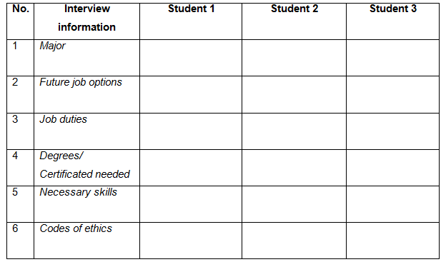

Slide 27

(1) What is your major and your future job option?
(2) What are your job responsibilities?
(3) What degrees/ qualifications do you need to have to get a good job?
(4) What skills do you need to have for your future job?
(5) What codes of ethics should you follow in your future job?

Slide 28

Objective: Upon completion of this activity, students will be able to talk about some information related to responsibilities, qualifications, skills, codes of ethics needed for future their jobs.
- Work individually
- Prepare a short talk based on suggestion questions below
- Present in front of the class
- Listen and give comments

Slide 29

Topic: Talk about codes of ethics, responsibilities, skills, qualifications/ degrees needed for your future job.
Suggested questions
1. What is your major and your future job option?
2. What are your job responsibilities?
3. What degree/ qualifications do you need to have to get a good job?
4. What skills do you need to have for your future job?
5. What codes of ethics should you follow in your future job?

Slide 30
Outline
Opening: Now, I’m the third-year student majoring in Information Technology at HaUI.
Job options: This major provides me a wide variety of job choices such as software engineer, programmer, webmaster, computer security specialist …
Job responsibilities: After graduation, I would like to become a web designer who is responsible for designing and programming the structure of websites using HTML, CSS, JavaScript… Additionally, I am also in charge of testing websites and monitoring online traffic and conversions.
Qualifications/certificates: Besides the bachelor’s degree in Information Technology, I need to obtain some other international certificates such as CDP, CCNA or CCNP … => beautify my CV and makes it outstanding.
Skills: I need to equip myself with necessary skills that will one day help me to perfect myself and fulfill my dream such as teamworking, problem-solving, communication skill, organization skill, interpersonal skill, especially coding skill.
Codes of ethics: To become a professional web designer and make contribution to maximizing the company’s value and profit, I myself need to follow a code of ethics. First, I must obey the laws, regulations and policies set by the company. Second, it’s important to respect intellectual property by saying no to plagiarism or duplicating. Moreover, I mustn’t spread malicious program code such as viruses or worms.
Ending: From now on, I’ll try my best and make continuous effort to accumulate useful knowledge of Information Technology and work-related skills to become an excellent web designer in the future.

Slide 31




